Slide 1
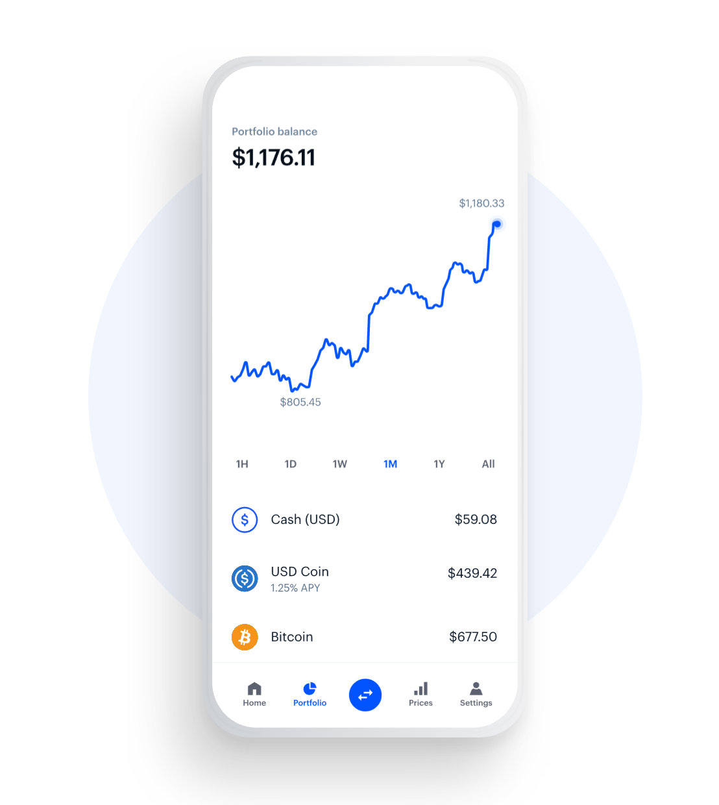


Our Attrition Analysis
(GROUP 7)
Jindal Jai - U2123034K
Koh Xin Yi Clarice - U2110183D
Lee Pei Yee - U2122590E
Shaun Lim Shi Lun - U2110811D

Slide 2
Pei Yee
Our Attrition Problem
0.8
Average Tenure Years

Slide 3
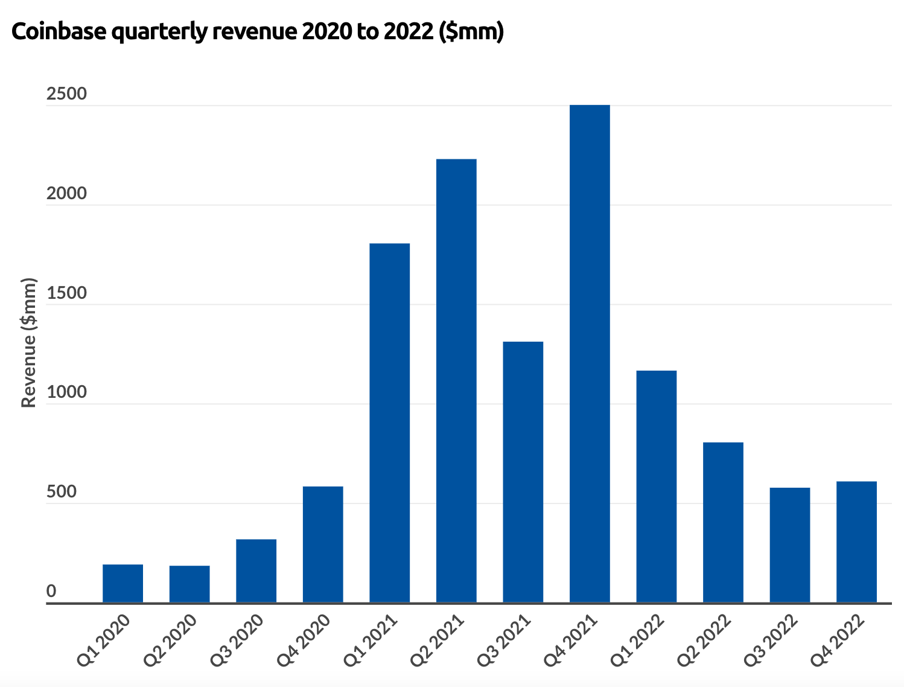


Pei Yee
Our Attrition Problem
Why is this so serious?
Company
Employees
Low Employee Morale
Low Productivity

Slide 4
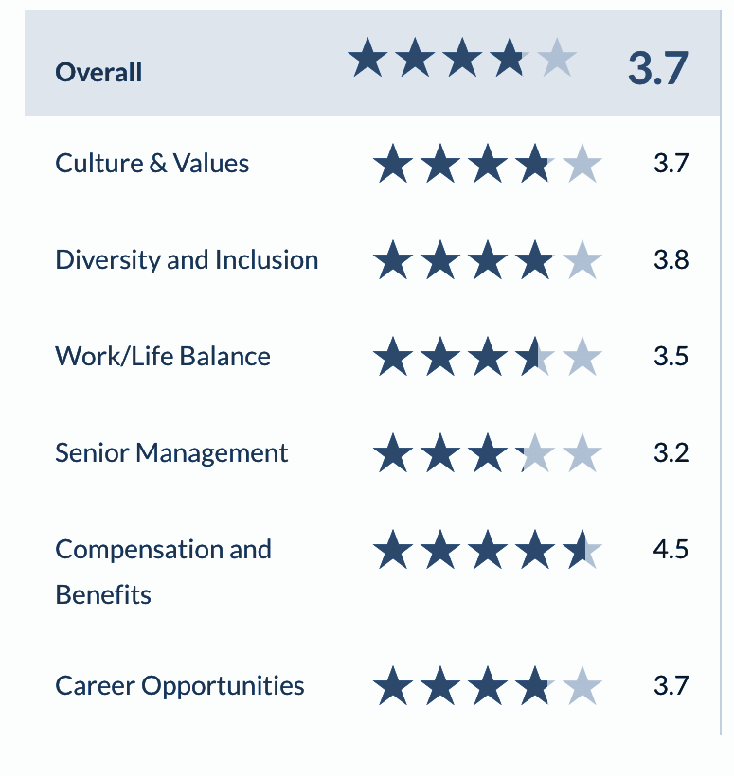
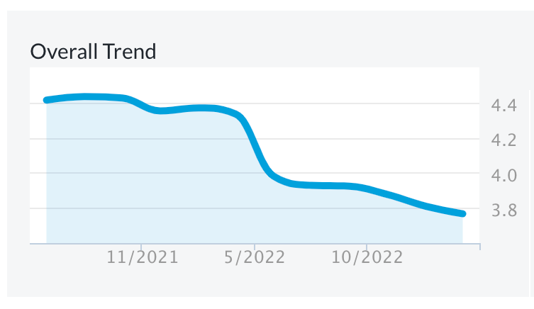
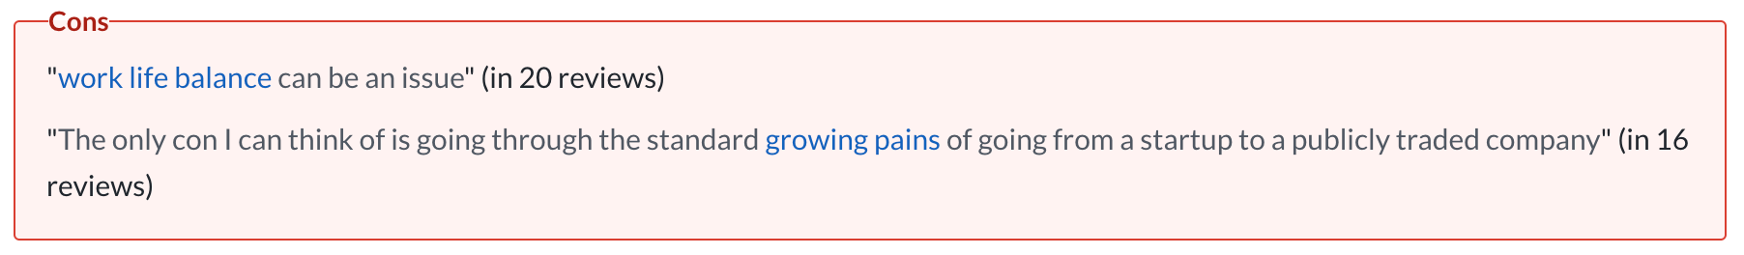
Pei Yee
Our Attrition Problem
What are the possible reasons?

Slide 5
Pei Yee
Our Attrition Problem
How effective are our current measures?
Remote-First
4 Recharge Weeks
“Champion Team” culture
“We have an intense work culture, and are regularly pushed out of our comfort zones.”
“We are a winning team, not a family, and have high expectations for performance and delivering results.”
52% employees recharge days and weeks were the primary tool that helped them rest and recover in 2021
In the long run, can Coinbase afford to give more recharge weeks? Are 4 recharge weeks going to be sufficient?

Slide 6
Pei Yee
Our Attrition Problem
What is our new Approach?
Identify root causes
of attrition
App
(Identify risky employees
who likely to leave)
Dashboard
(Visualisation of attrition
trends)
Key Objectives
1
What are the primary factors contributing to the high employee turnover rate at Coinbase?
2
What are the factors that are important to developers’ job satisfaction and how can Coinbase leverage this information to fuel their growth and better retain more developers?
3
How can Coinbase design customised retention plans that take into account the particular requirements and worries of various employee groups?
4
How can Coinbase track and assess the effectiveness of its retention guidelines over time and make any necessary data-driven adjustments?

Slide 7
Pei Yee
Prediction of Attrition Using Machine Learning
Machine Learning Workflow
Initial Coinbase Dataset
Data Visualisation and Exploration
Feature Selection
Logistic Regression
Random Forest
SMOTE Sampling
Train Dataset
Model Evaluation
Model Prediction
CART
MARS
Random Forest
Optimised Coinbase Dataset
Test Dataset

Slide 8
Pei Yee
Data Cleaning and Preprocessing
Age
Attrition
BusinessTravel
Department
Education
EnvironmentSatisfaction
Gender
JobInvolvement
JobLevel
JobRole
JobSatisfaction
MaritalStatus
MonthlyIncome
NumCompaniesWorked
OverTime
PercentSalaryHike
PerformanceRating
RelationshipSatisfaction
StockOptionLevel
TotalWorkingYears
TrainingTimesLastYear
WorkLifeBalance
YearsAtCompany
YearsInCurrentRole
YearsSinceLastPromotion
YearsWithCurrManager
Initial Coinbase Dataset
1470 employees
26 Columns
Predictor Variable: Attrition
25 Independent Variables (numerical and categorical)
No missing values
Outliers are not removed
One-Hot Encoding of categorical variables

Slide 9
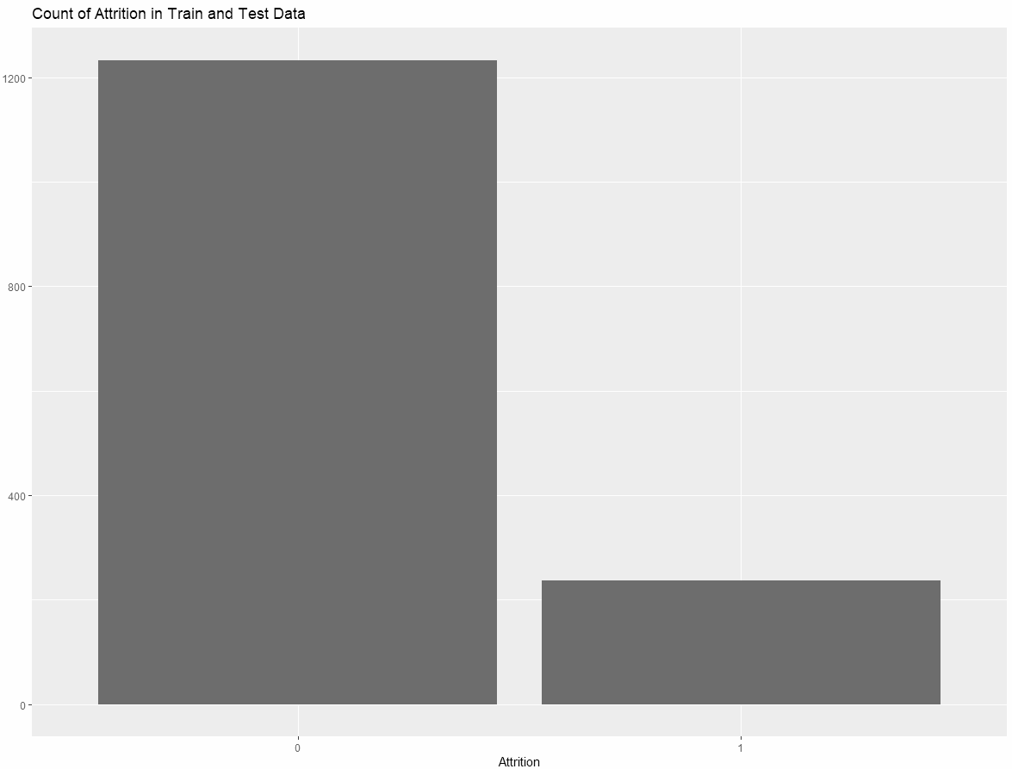
Pei Yee
Univariate Data Exploration and Visualisation
Key Insight 1: Severe Class Imbalance between Attrition 0 (leftside) and 1 (rightside)

Slide 10
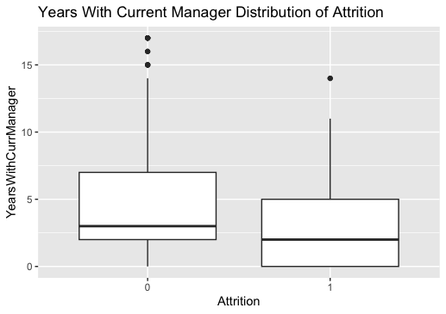
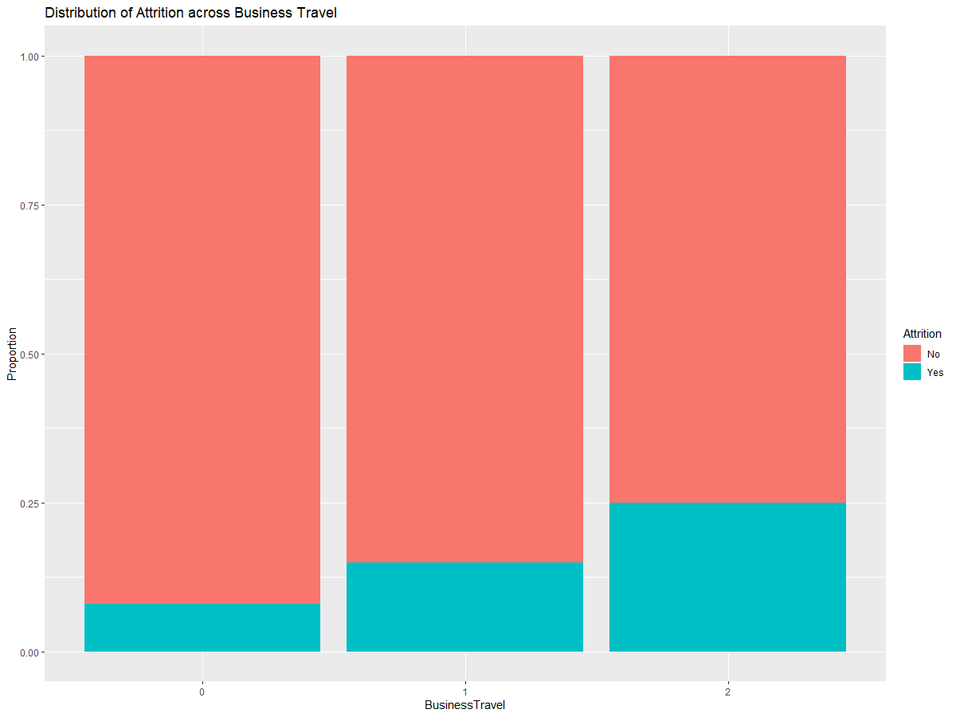
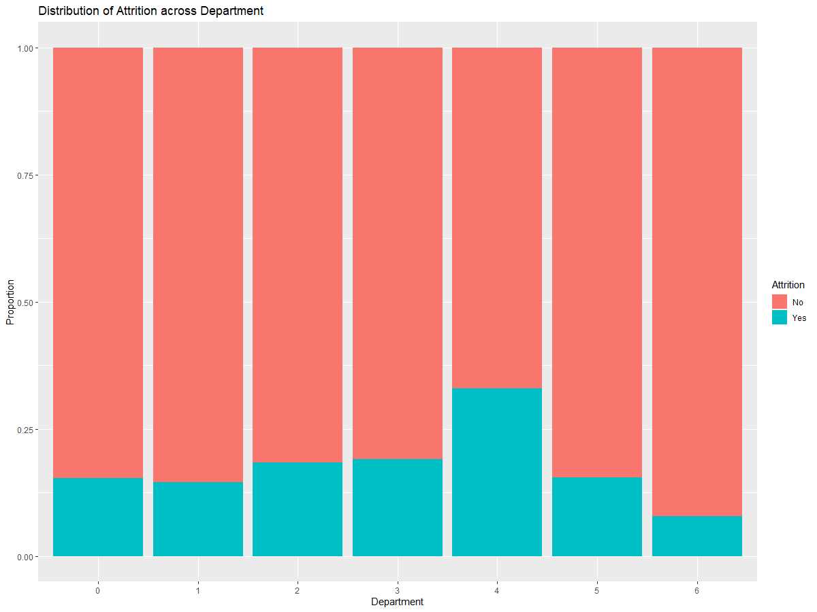
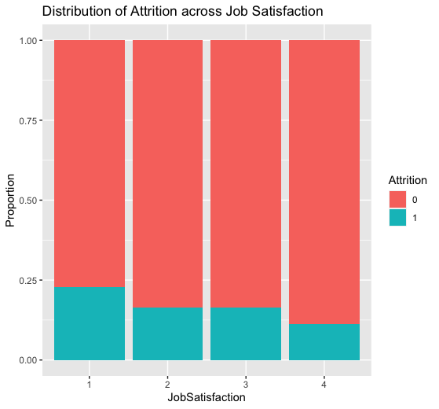
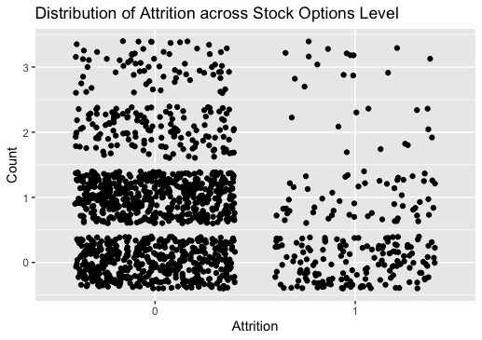
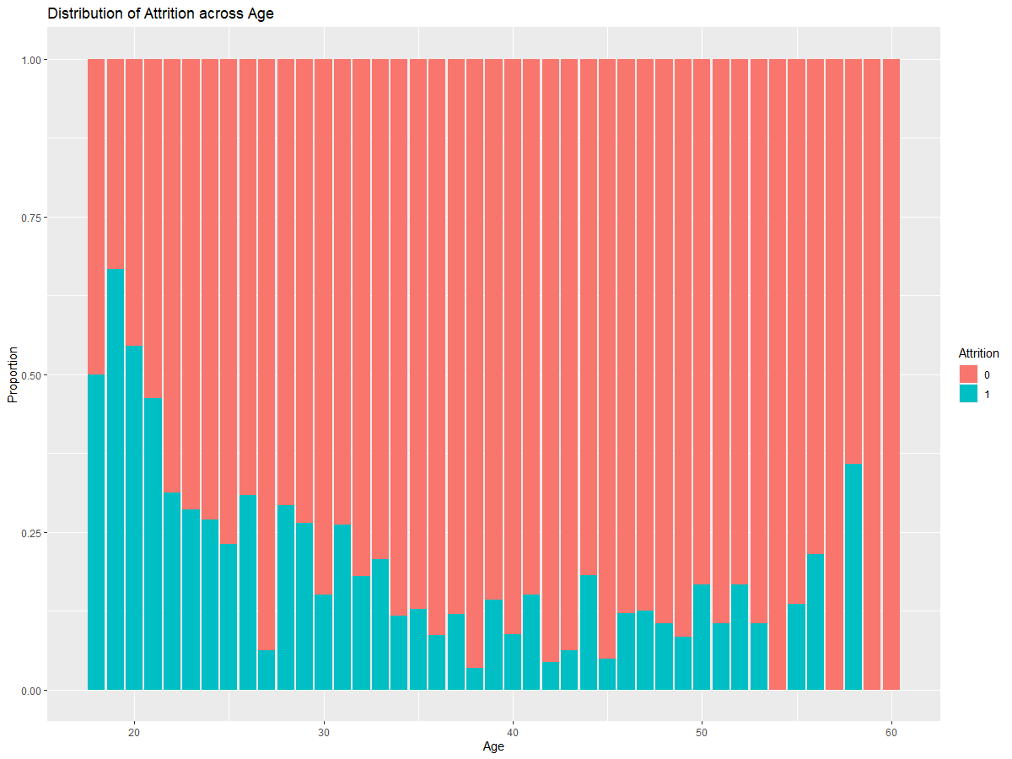
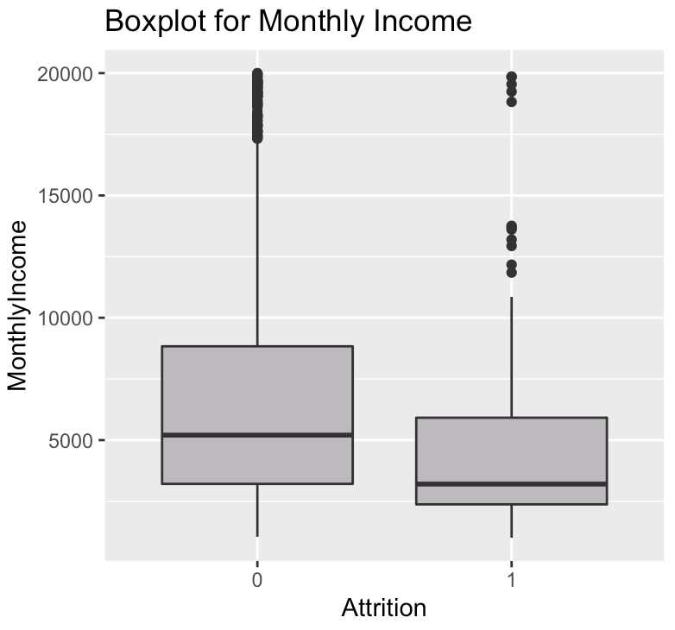
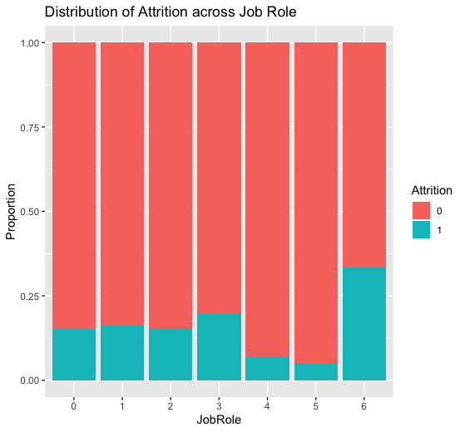
Pei Yee
Univariate Data Exploration and Visualisation

Slide 11
Pei Yee
Univariate Data Exploration and Visualisation
Interesting Insights from Data Visualisation
Younger employees were more likely to leave the company | Employees who left prefer fewer business travels | Marketing & Communications Department has the highest attrition rate | Employees stay in jobs that require higher level of involvement
Employees with low job satisfaction have tendency to leave the company | Environmental satisfaction below 2 has higher attrition rate | Lower paying employees are likely to leave | Majority of employees who left are single
Employees who did overtime are likely to leave | Majority of employees who left have less than 10 years of working experience | Employees who have poorer work life balance are more likely to leave | Most employees prefer to stay in the current job role
Business roles have lower rate of retention than technical roles and managerial roles | Employees who have changed more than 4 and less than 2 companies more likely to leave | Majority of employees left within 5 years after promotion | Majority of employees leave within 2.5 years after their manager is changed
Key Insight 2: Some factors have more significant influence to Attrition than others

Slide 12
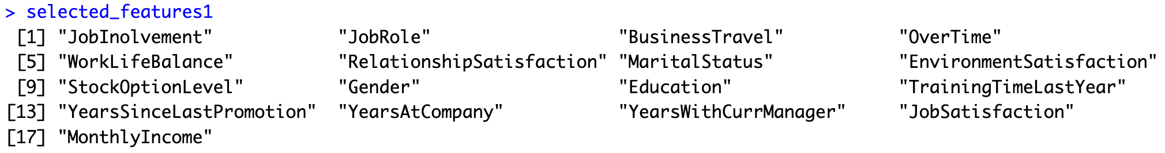
Pei Yee
Feature Selection
Why?
Remove features that exhibit high multicollinearity with other independent variables based on the Variation Inflation Factor (VIF)
Variables dropped
“Department”: Perfect Multicollinearity with Job Role
“Job Level”: GVIF Score of 43.259 with Monthly Income
2 Selection Conditions
p-values < significance level of 0.05
high magnitude of coefficient estimates in the regression line
17 Important Features
Logistic
Regression

Slide 13
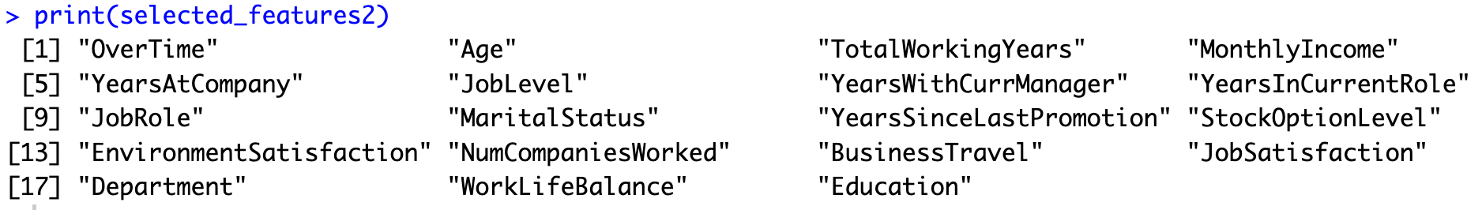
Pei Yee
Feature Selection
Why?
Automatically and quickly filter through a large number of variables and remove unimportant features
Not affected by multicollinearity between factors
Selection Condition
mean decrease in Accuracy and Gini Impurity when the influence of that variable is removed via permutation
19 Important Features
Random
Forest

Slide 14
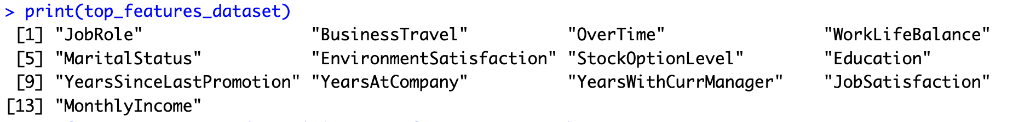
Pei Yee
Feature Selection
Why?
Remove unimportant/irrelevant features can improve accuracy
Lower computational costs and time
13 common variables in both sets of variable importance
Test
Accuracy
86.39%
Test
Accuracy
87.07%
Final Key
Predictors
26 Features 13 Features

Slide 15


Shaun
3 Models
Evaluation & Decision

Slide 16
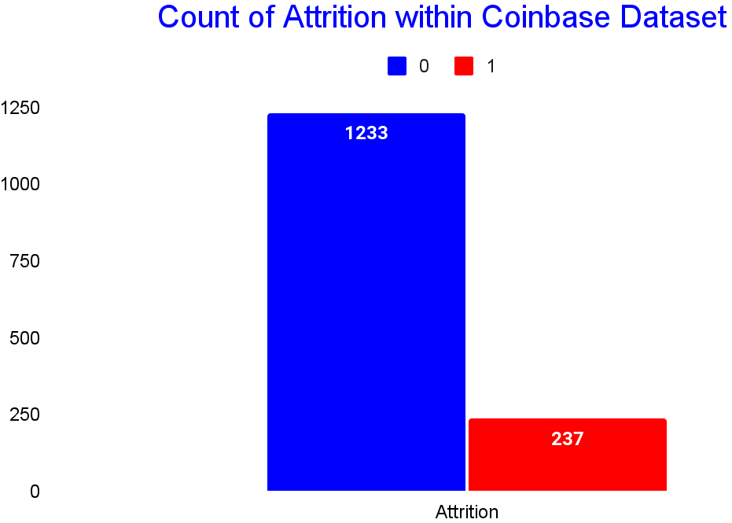

Shaun
Our Aim
Testing and Training through 3 Models
CART
MARS
Random Forest

Slide 17
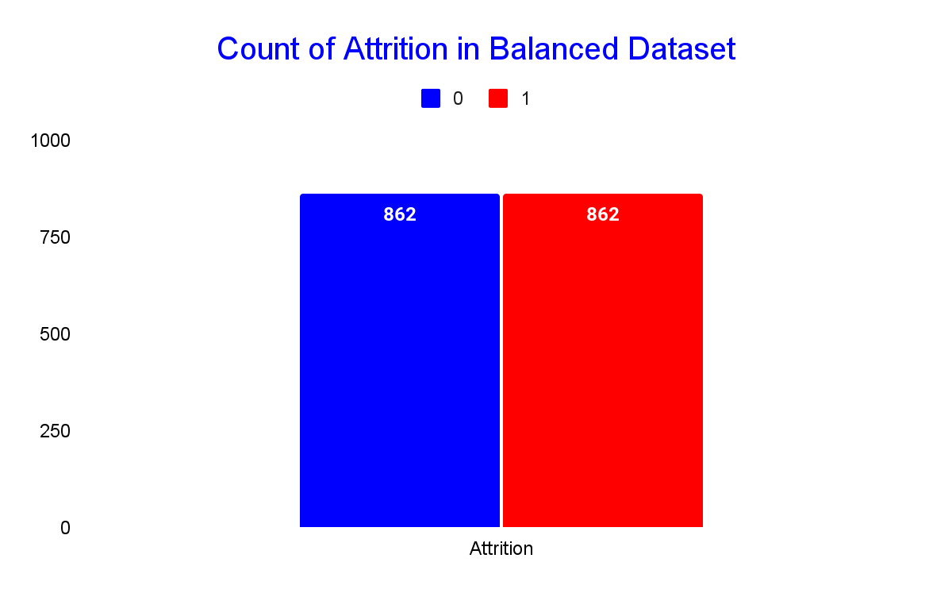
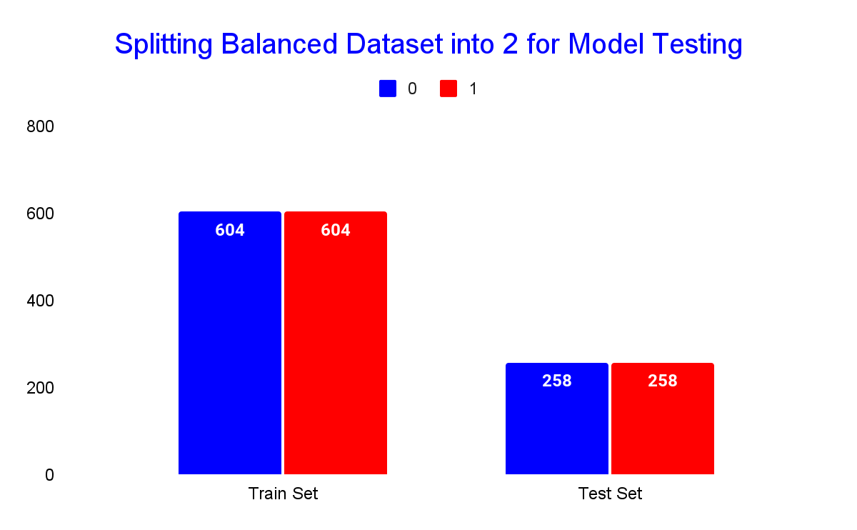
Shaun
Balancing the Dataset
Synthetic Minority Oversampling Technique (SMOTE)

Slide 18
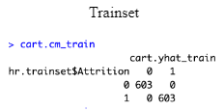
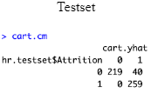
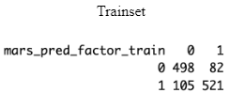
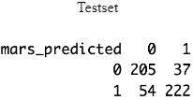
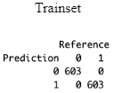
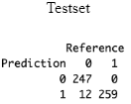
Shaun
3 Models
CART
MARS
Random Forest
Classification and Regression Trees
Multivariate Adaptive Regression Splines
Ensemble Learning Method
A decision tree algorithm that recursively splits the data into smaller subsets based on the variables that are most informative for predicting the target variable (Attrition). This results in a series of if-then statements that can be used to make predictions.
A flexible and interpretable regression model that can handle nonlinear relationships between predictor variables and the target variable (Attrition). It is capable of capturing interactions between variables and automatically selects the most relevant predictors.
Combines multiple decision trees to improve the accuracy and robustness of the predictions. It randomly samples the data and features to create each tree, and the final prediction is made by aggregating the predictions of all the trees.

Slide 19
Shaun
Performance Evaluation
Model | Accuracy | False Positive Rate | False Negative Rate | Precision | Recall
CART | 92.2% | 15.4% | 0% | 86.6% | 100%
MARS | 82.4% | 20.8% | 14.3% | 80.4% | 85.7%
Random Forest | 97.7% | 4.6% | 0% | 95.6% | 100%
Accuracy: % of Predictions that were correct
False Positive: Instances where the model predicted an employee to leave, but he actually stays
False Negative: Instances where the model predicted an employee to stay, but he ends up leaving
Precision: % of correct predictions of employees leaving over all predictions of Attrition = 1
Recall: % of correct predictions of employees leaving over all real instances of Attrition = 1

Slide 20
Shaun
Evaluation
01
4.6% False Positive Rate
For every 1000 positive predictions, 46 might be wrong
Employees with no intention to leave, might be predicted to be leaving
Acceptable to have this compared to False Negatives
02
2.3% Inaccurate Prediction
For every 1000 predictions done, 23 of them might be wrong
Not a significant challenge for the HR team
03
Optimisation of Model
Model was done with default parameters
Hyperparameters Tuning for RF, 10 Fold CV for MARS
Possible to get higher accuracy / Lower False Positive Rate

Slide 21

JAI
Solution 1:
Attrition Prediction WebApp

Slide 22





JAI
Purpose of WebApp
Users:
Senior Management & Human Resources
Toggle between various Variables to predict how different Variables affect Attrition
Predict Specific Employees who are at a Risk of Leaving
Receive Highly Specialized Recommendations for each specific Employee who is at Risk of Leaving

Slide 23



JAI
App Features (Main Page)
Navigation to Attrition Prediction Tab

Slide 24
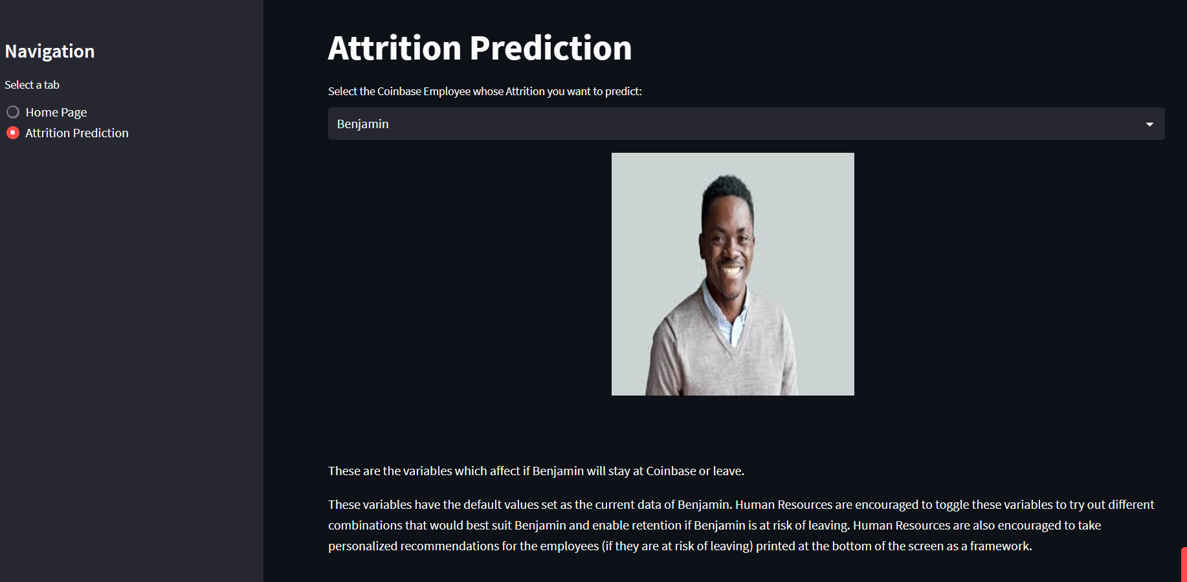
JAI
App Features (Attrition Prediction)
Load Employee Profile

Slide 25
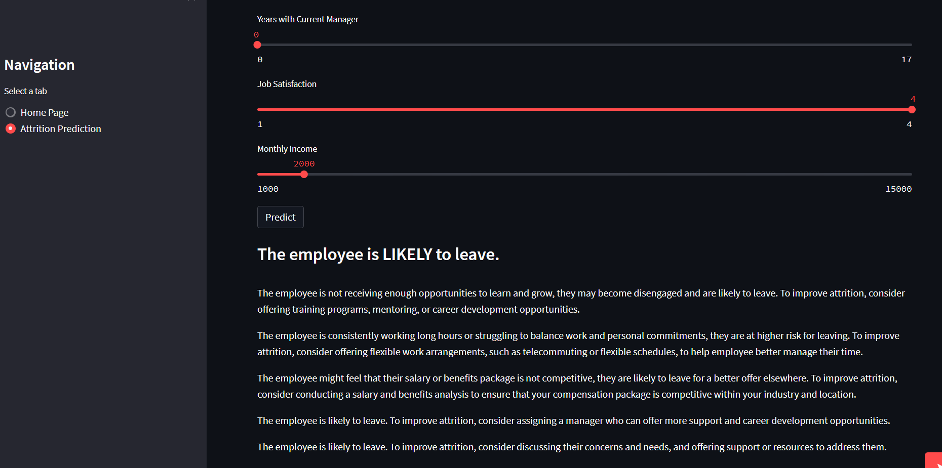
JAI
App Features (Main Page)
Attrition Prediction using Random Forest using Variables given above
Personalized Recommendations specific to each employee

Slide 26

JAI
With what accuracy will the App predict the Attrition?
The App looks fancy but how much will it cost?
How effective will the App actually be?
Every Analytics team in the world recommends an App, but they never make it past the initial stage? How is this different?
How soon can we get the App running for Coinbase since its an urgent situation?

Slide 27

JAI
SCAN TO
GET
STARTED
https://jaijindal-bc2407-s1team7-attrition-ap-bc2407-s1team7-app-7bzpob.streamlit.app/

Slide 28
Clarice
Solution 2:
Attrition Dashboard

Slide 29
Clarice
Purpose of Dashboard
Dashboard Users:
Senior Management & Human Resources
Measure Effectiveness of Current Policies
Develop an Enhanced Job-role Wide Strategy

Slide 30
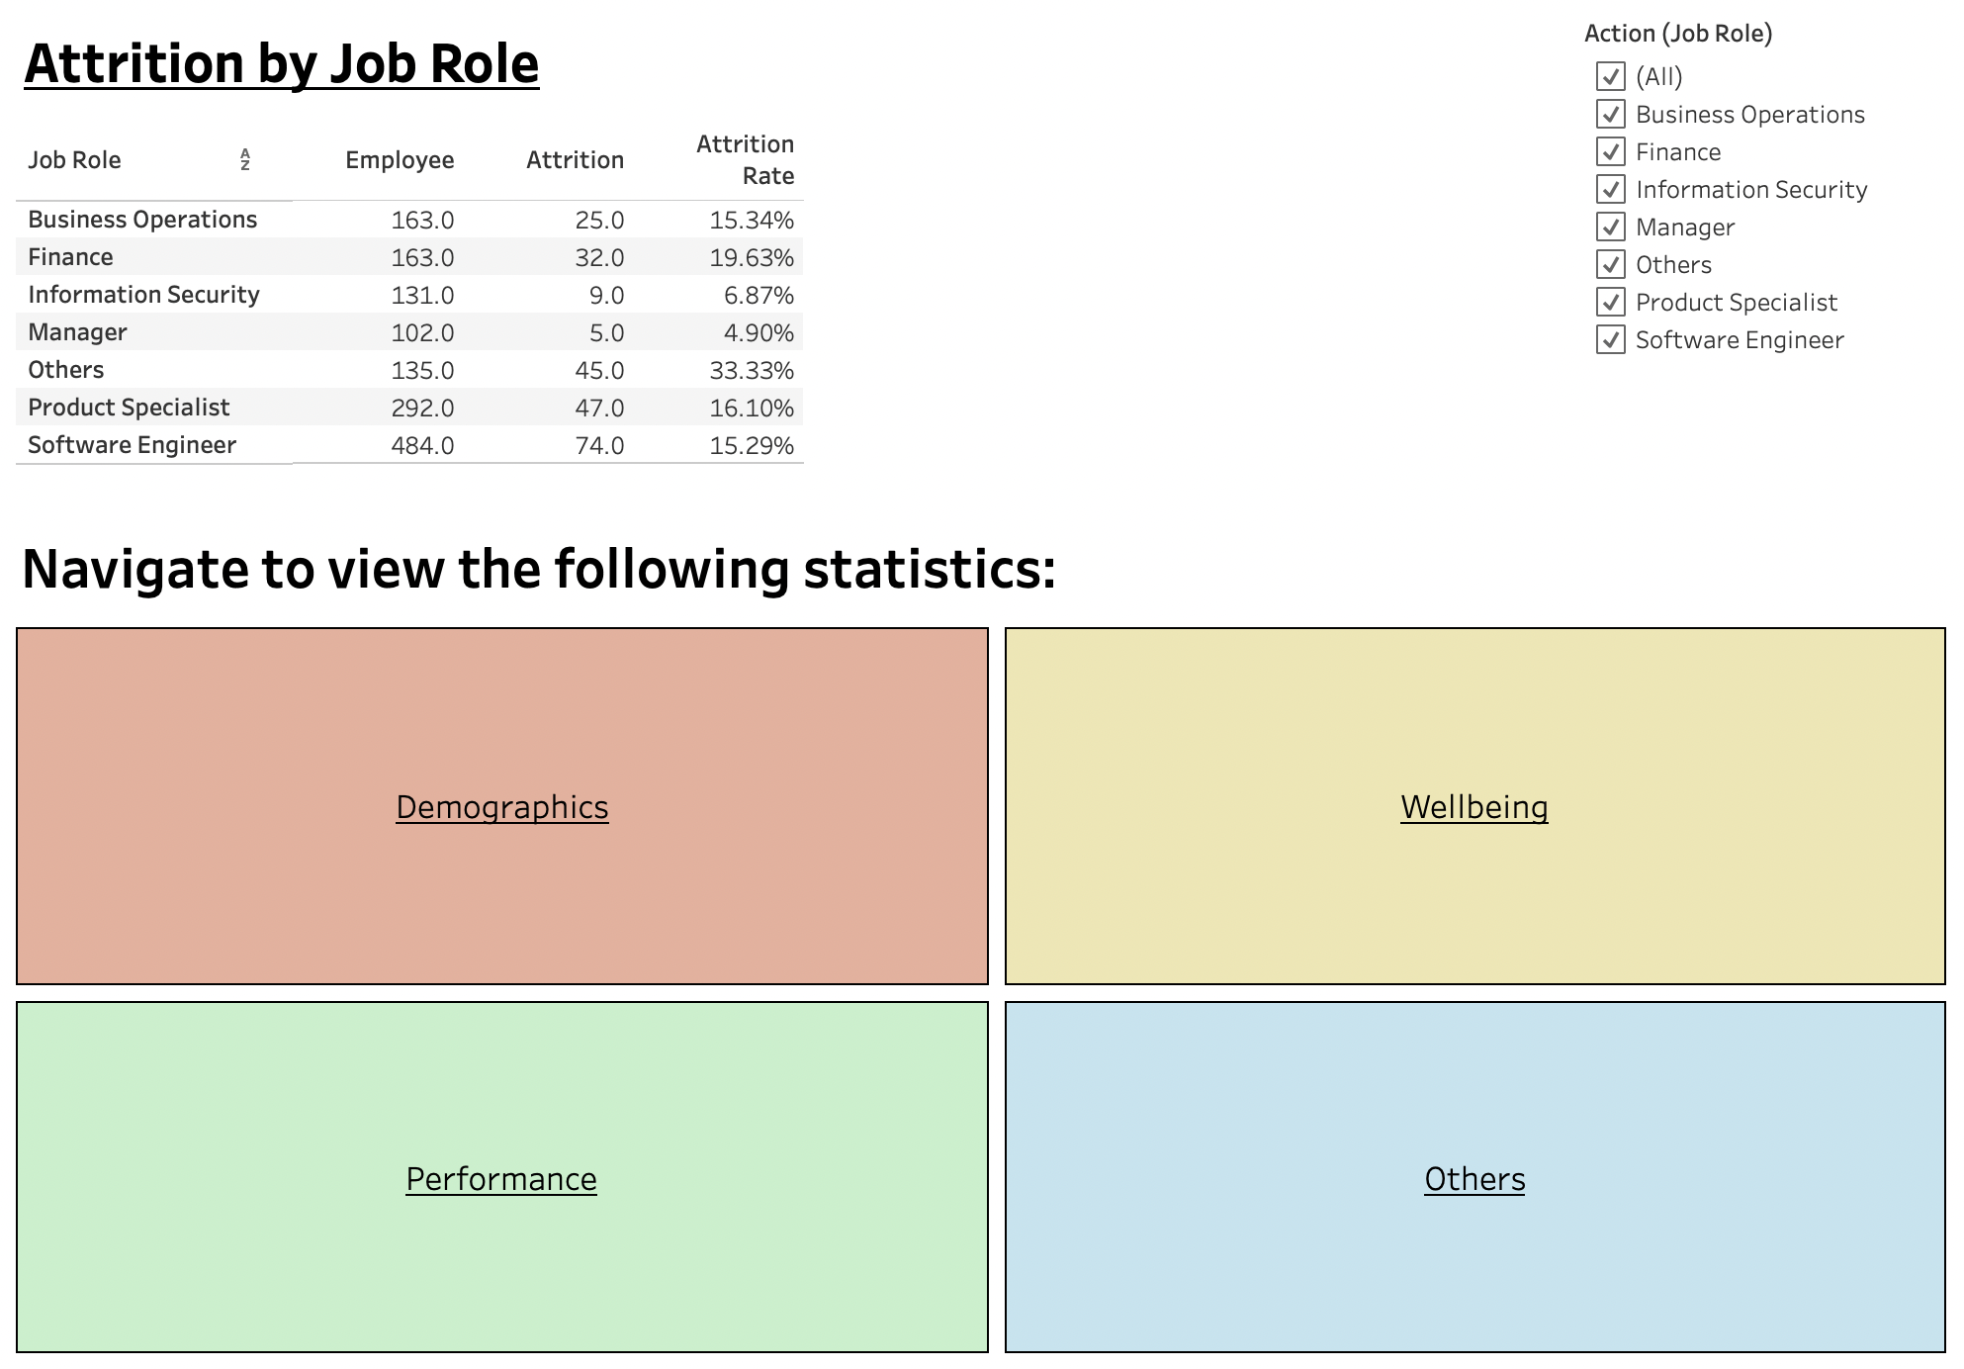
Clarice
Dashboard Features (Main Page)
Key Performance Index (KPIs)
Navigate to one of the
four domains

Slide 31
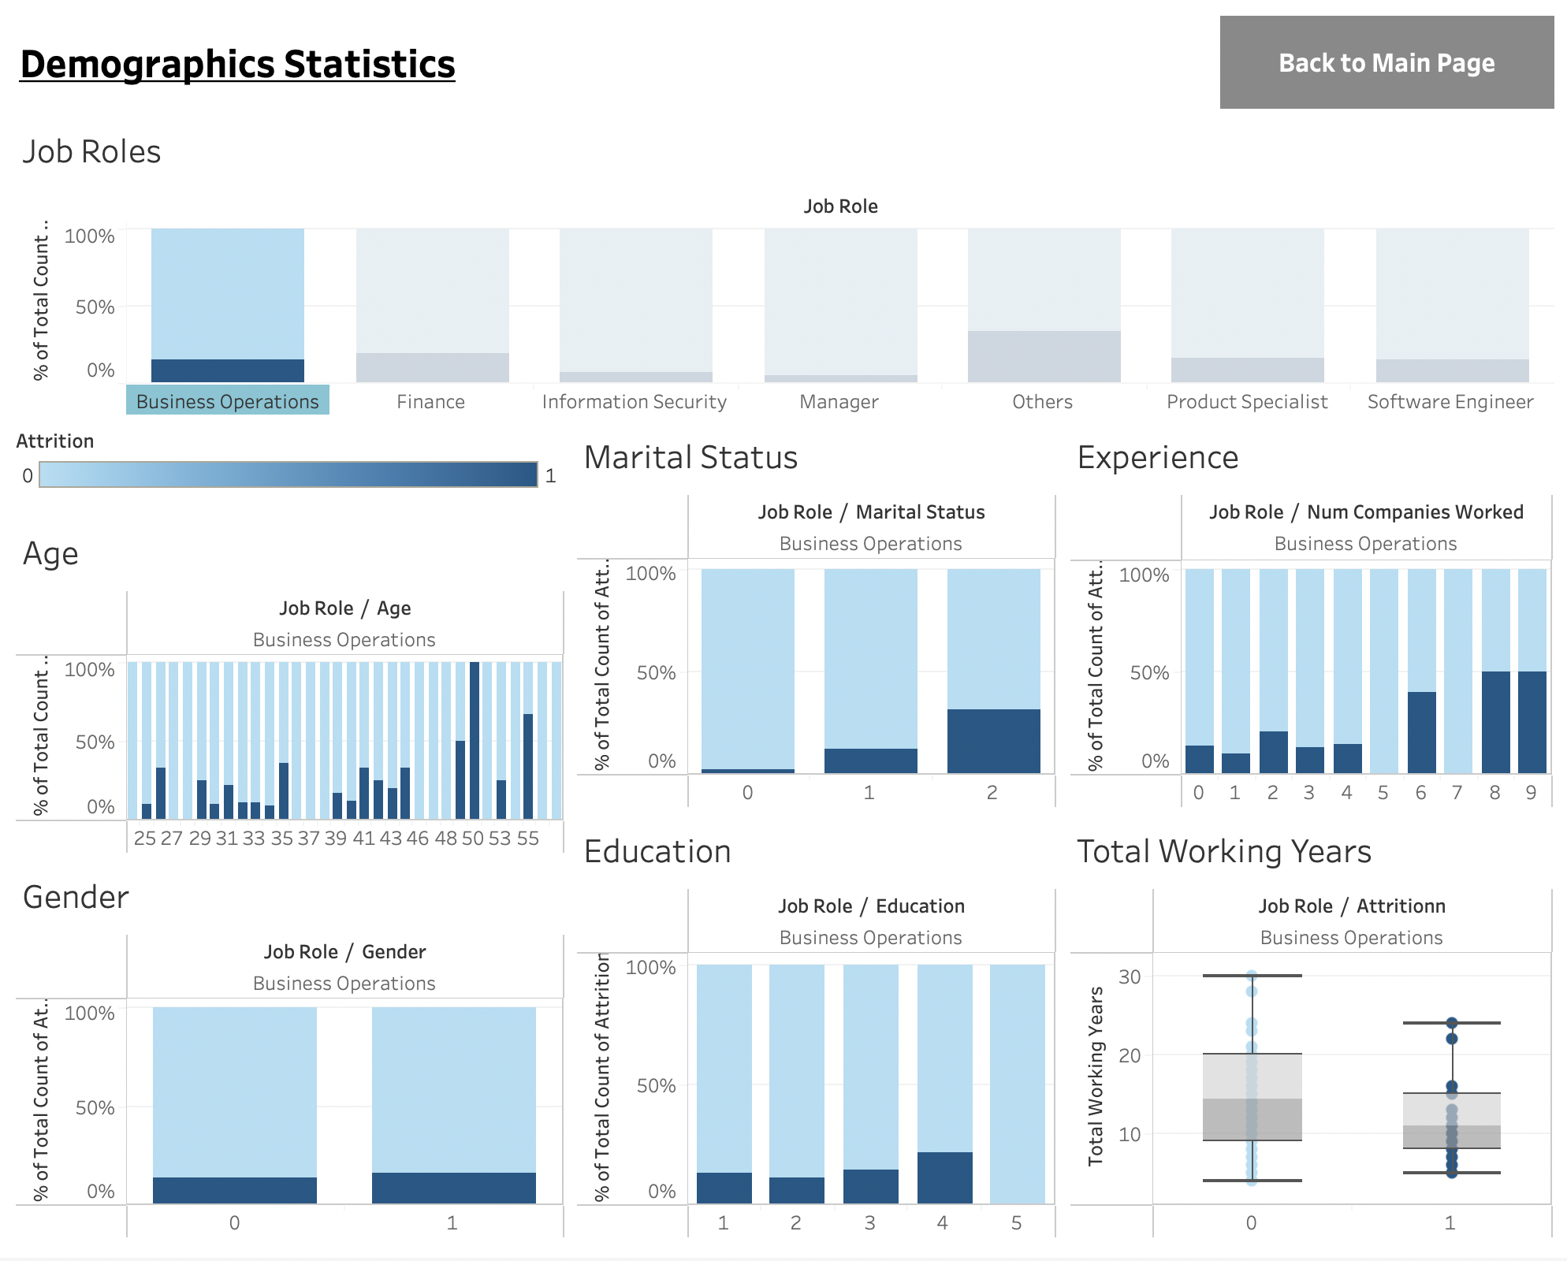
Clarice
Dashboard Features (Demographics Domain)
Filter Job Roles
Legend / Key
Demographic Attributes

Slide 32
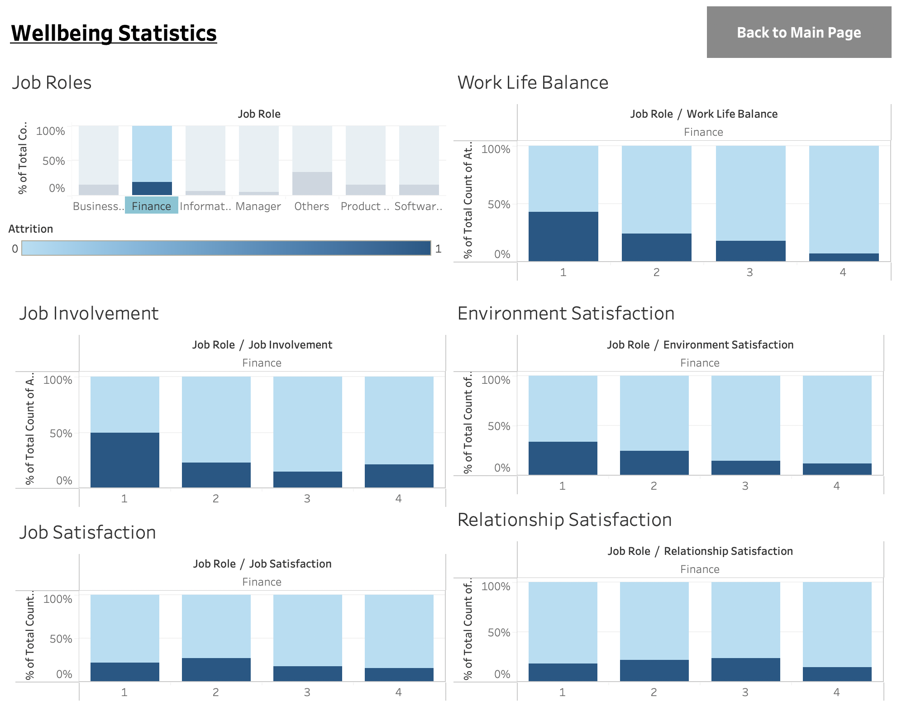
Clarice
Dashboard Features (Wellbeing Domain)
Filter Job Roles
Wellbeing Attributes

Slide 33
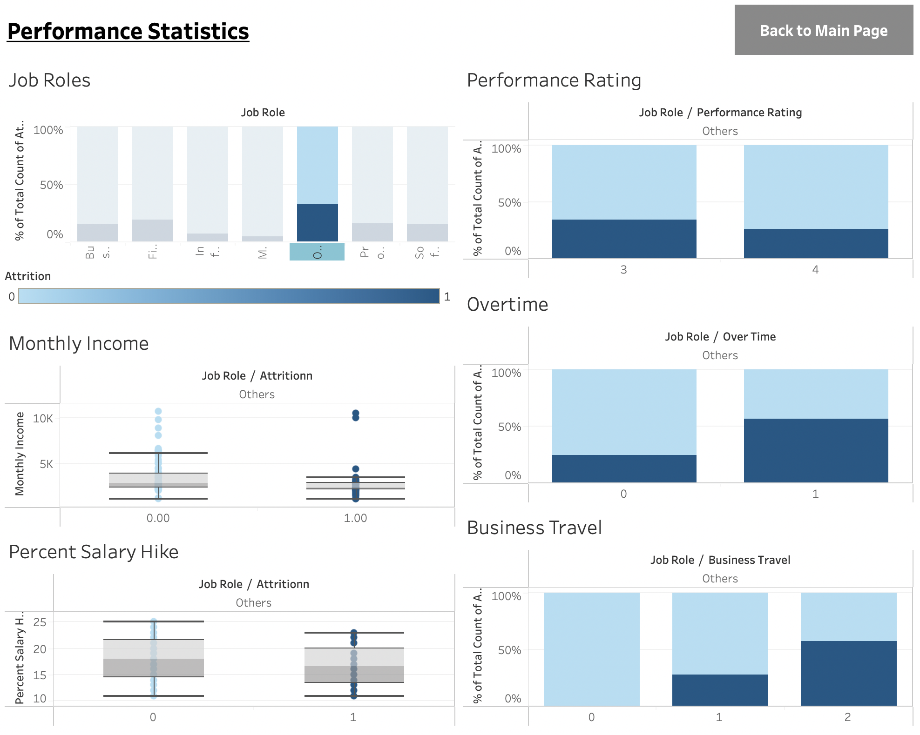
Clarice
Dashboard Features (Performance Domain)
Filter Job Roles
Performance Attributes

Slide 34
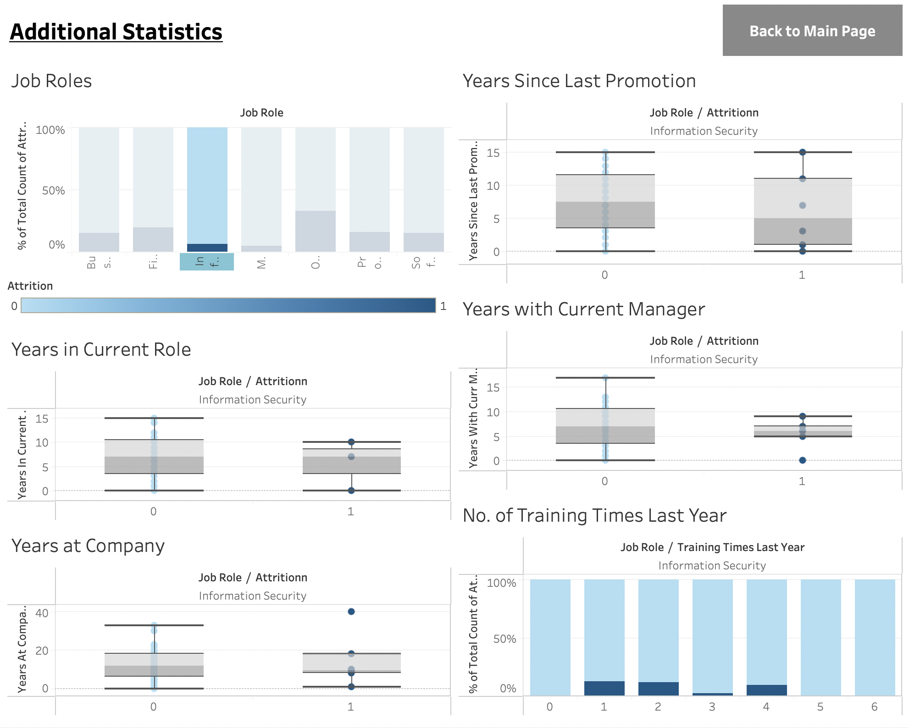
Clarice
Dashboard Features (Others Domain)
Filter Job Roles
Other Attributes

Slide 35

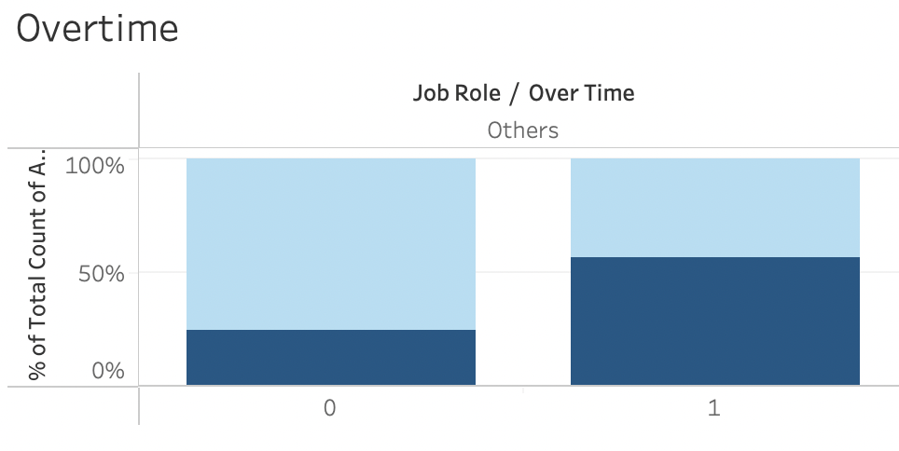
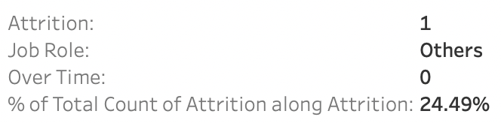
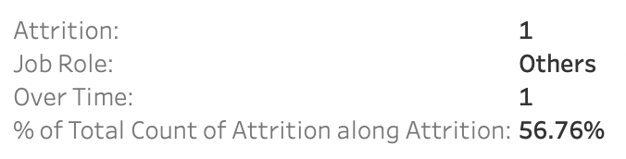
Clarice
Usage of Dashboard
Main Dashboard Performance Domain Job Role: Others
Conclusion: “Overtime” is a key factor contributing to High Attrition (Ineffective Current Strategy/ Need to Devise New Strategy)

Slide 36
Clarice
Dashboard Demo

Slide 37
Clarice
Limitations &
Mitigations

Slide 38



Clarice
Limitations
Effective in:
Accurately identifying employees at High Risk of Attrition
Highlighting Key Contributory factors leading to Attrition
Limitations:
Hard to quantify complex factors such as “Job Satisfaction”
Limitations in recommending related solutions
Random Forest Model
Predictive App
Dashboard

Slide 39
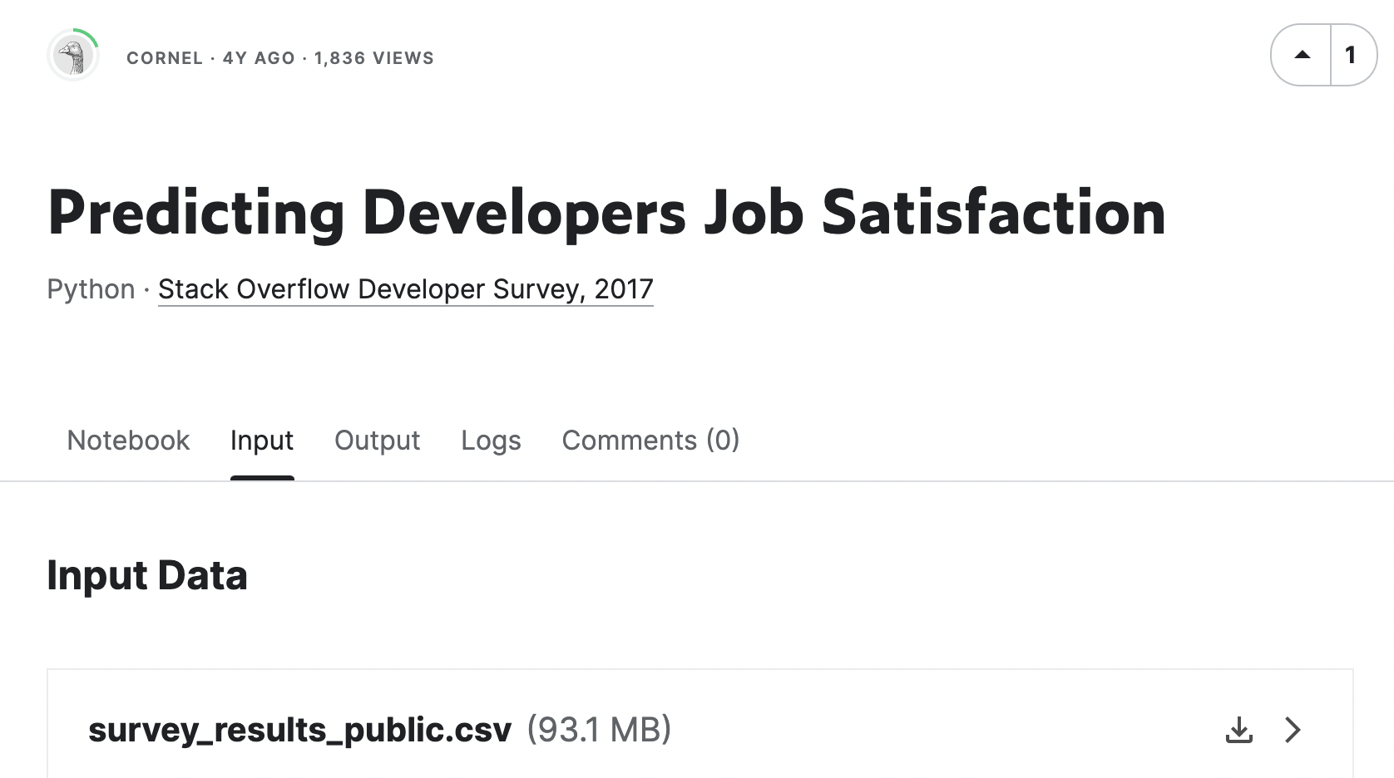
Clarice
Mitigations
Methodology (How to Improve Job Satisfaction):
Used a second dataset
Selected related columns that focus on full-time employees with similar working characteristics as Coinbase
Created Data Visualizations to better understand attributes contributing to “Job Satisfaction”
Shortlisted Key Attributes based on 2 Criterias:
1) Majority of respondents selected that Benefit
2) The attribute has a significant trend across different levels of Job Satisfaction
Conclusion:
Key Benefits: Expected work hours, Vacation/days off, Health, Retirement and Remote Options
Supplementary Benefits: Annual Bonus, Long Term Leave and Equipment
(Can be adjusted depending on the current distribution of employees’ Job Satisfaction)

Slide 40

Clarice
Future Expansion of
Solutions

Slide 41
Clarice
App Expansion
Provide Real-Time Updated Insights & Notifications
Categorise Employees according to likelihood of Attrition

Slide 42
Clarice
Dashboard Expansion
Forecast Predicted Attrition Rates
Retain Past Data to analyze Trends

Slide 43

JAI
Conclusion

Slide 44


JAI
Intended Goals
What are the primary factors contributing to the high employee turnover rate at Coinbase?
What are the factors that are important to developers and how can Coinbase leverage this information to fuel their growth and better retain more developers?
How can Coinbase design customised retention plans that take into account the particular requirements and worries of various employee groups?
How can Coinbase track and assess the effectiveness of its retention guidelines over time and make any necessary data-driven adjustments?

Slide 45

JAI
Final Solution
Our 2 solutions , work hand in hand - Dashboard provides broad and comprehensive insights at the company level while App gives detailed and customised predictions and recommendations at an employee level.

Slide 46




JAI
Future Expected Outcome
Attrition=16.2%
Attrition=11.2%
$3 Million/Yr

Slide 47

Thank you!

